Slide 1

Business Management for IT
(IT3090)
Managing People
(Lesson 3- PART I)
站长素材 SC.CHINAZ.COM
Chalani Kuruppu
MLRHRM (Col.), PGD.LRHRM (Col.) BBA (Hons) (Sheff Hallam),

Slide 2

LEARNING OUTCOMES
At the end of the lecture, students should be able to;
Understand the basic concepts of Human Resource Management (HRM).
Define HRM.
Provide an overview of functions of HRM.
Understand the significance of human resource.

Slide 3

WHAT IS HRM?
What is Management?
What are the resources available in an enterprise?
What is Human Resource?

Slide 4
Employees as a resource
Is being developed over the time and experience
Not depreciated, but, being a continuously developing asset
Has the ability of creativity and innovation
Makes decisions in respect of all other resources
Something valuable, really hard to quantify the exact value
Something to be developed
Something to be compensated
Something to be carefully managed
Something to be carefully maintained and retained
Something, really needed to sustain the competitiveness

Slide 5



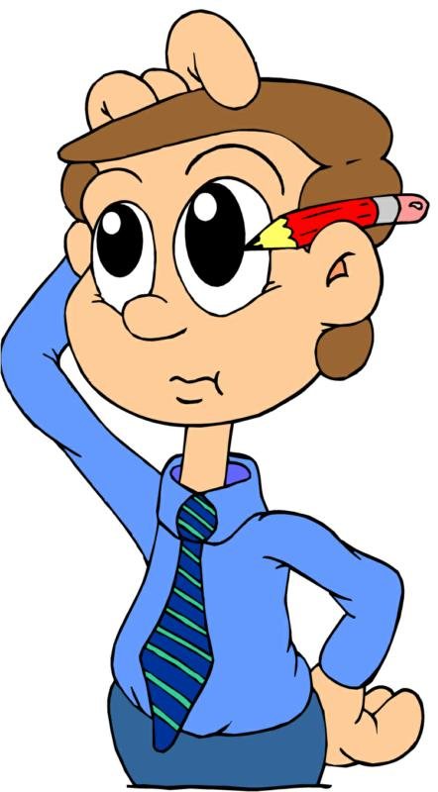



Other resources make things possible but only human resources make things happen.

Slide 6

WHY DOES HRM IMPORTANT TO ALL MANAGERS
The losses due to hire the wrong person for the job
Experience high turn over
People not doing their best
Waste time with useless interviews
Legal responsibility

Slide 7





Slide 8

Efficient and effective utilization of human resource to achieve goals of an organization
HRM examines what can or should be done to make people more productive and satisfied.
HRM is the effective management of people at work
Simple Definition
If the human resource is mismanaged or neglected, organizations would not be able to achieve their goals as expected.

Slide 9
An organization?
A collection of people works together for achievement of common goals.
Efficiency?
A productivity metric
Describes how fast a person/ product can do something
Optimum use of HR by minimizing wastage
Comparison of number of employees and cost
Utilize the right people in the right number with the right cost at the right job
Effectiveness?
A quality metric
Describes how good a person/ product considering what he or the product is expected to be.
Employees who demonstrate effectiveness in the workplace help produce high-quality results.

Slide 10
A model of
Human Resource Management
Performance Evaluation
Pay Management
Objectives
. Procurement of right people in the fight way.
. Retention of the most appropriate employees.
. Employee Commitment
. Employee Motivation
. Control of Employment Costs
Training & Development
Strategic Goals
. Improvement of Employee Productivity.
. Employee Development
. Enhancement of Quality of Work Life.
. Ensuring Legal Compliance.
Generic Goal
To generate and retain in appropriate and contented employee force which gives the maximum individual contribution to organizational success.
Job
Analysis
Job
Design
Employee movements
Human Resources Planning
Recruitment
Selection
Hiring &
Induction
Management of Incentives
Welfare Administration
Health & Safety Administration
Discipline Management
Grievance Handling
Labour Relations Management
Source: Opatha, 2002, performance Evaluation of Human Resource,

Slide 11


HR Planning

Slide 12
Human Resources Planning
HRP is the “process of determining future employee needs and deciding steps or strategies to achieve those needs for the purpose of accomplishing organization goals and objectives”.
HRP is the “process of assessing the organization’s human resource needs in the light of organizational goals and making plans to ensure that a competent, stable workforce is employed”.

Slide 13
HRP Process
1. Forecast future demand for HR
2. Estimate HR supply
3. Compare forecast demand with estimated supply
4. Develop strategies to be taken
5. Assess HRP effort
Feedback

Slide 14
Demand Forecasting
Demand forecasting is the process of estimating the future numbers of people required and the likely skills and competences they will need.
anupama.d@my.sliit.lk

Slide 15
Forecasting supply of human resources
Supply forecasting measures the number of people likely to be available from within and outside the organization, having allowed for attrition (labour wastage and retirements), absenteeism, internal movements and promotions, and changes in hours and other conditions of work.
Supply of inside candidates (internal supply)
Supply of external candidates (external supply)

Slide 16
Strategies in surplus conditions of HR
Freeze hiring
Attrition (voluntary departure)
Early retirement on voluntary basis
Reduction of reward expenditure
Lay off
Termination

Slide 17
Strategies in shortage conditions of HR
Have current employees work overtime
Subcontract work to other firms
Provide opportunities for learners for a period of time
Hire part-time employees
Hire casual employees
Hire temporary employees
Hire permanent full-time employees

Slide 18
HRP Considerations
Balancing supply and demand

Slide 19
Recruitment

Slide 20

Recruitment
Recruitment is the process whereby an organization communicates opportunities and information to the labour market in order to attract the quantity and quality of potential employees in requires to fulfil its human resource plan.
Recruitment is the part of the human resourcing process concerned with finding the applicants: it is a positive action by management, going into the labour market, communicating opportunities and information and encouraging applications from suitable candidates.
Recruitment

Slide 21

How to Recruit
Internal Recruitment
External Recruitment
Simple word of mouth
Job Postings and bidding
Newsletters
Succession Planning
Eg: Promotion
Skills inventories
Intranet
Advertising
Employment Agencies
- Govt. Employment exchange
- Private agencies
Head hunters
Campus
Referrals
Internet / e- recruitment
Past employees
Recruitment

Slide 22
Selection

Slide 23
Selection
Selection is the process of making the choice of the most appropriate person from the pool of applicants recruited to fill the relevant job vacancy.
Determining applicants who have the highest capability to produce the desired job performance occurs in selection.
It involves the use of one or more methods to assess candidates in order to make a decision as to their suitability to perform duties and responsibilities of the job successfully.
There is a difference between “the most appropriate person” and “the most qualified person”. The most appropriate perform from a pool of job may be the most qualified person or not.
The selection systematically attempts to choose the person who suits best with the job/ person specification relevant to the job vacancy.
Recruitment
anupama.d@my.sliit.lk

Slide 24
Steps in Selection Process
Screening of applications
Tests
Interviews
Reference Checks
Medical Examination
Selection

Slide 25
Performance Appraisal

Slide 26
Definition
A systematic way of reviewing and assessing the performance of an employee during a given period of time and planning for his future.
Performance appraisal programs are most helpful tools an organization can use to maintain and enhance productivity and facilitate progress towards strategic goals.
Performance Management and Appraisal

Slide 27
Objectives of Performance Appraisals
Help employees and supervisors do their jobs better
Improve communications and trust
Provide people with clear direction
Identify performance problems early
Reinforce good performance
Make process fairer; people are more likely to accept
Performance Management and Appraisal

Slide 28
Appraisal Method
Behavior Appraisals
Assesses how workers perform their jobs—the actual actions and behaviors that exhibit on the job.
Focuses on what a worker does right and wrong and provides good feedback for employees to change their behaviors
Results appraisals
Managers appraise performance by the results or the actual outcomes of work behaviors
Performance Management and Appraisal

Slide 29
Appraisal Method
Trait Appraisals
Assessing subordinates on personal characteristics that are relevant to job performance.
Performance Management and Appraisal

Slide 30
360 degree PE
SUPERIOR
CUSTOMERS
TEAM
PEERS
SELF
SUBORDINATES
Performance Management and Appraisal

Slide 31
Thank you
站长站素材 SC.chinaz.COM

